Slide 1
Discussion Questions
What benefit do we get from layers? What division of labor makes sense? Did the layers have to be the ones that they are?
When is it okay to blur the layer boundaries? When is it not okay?
Do we really need IP addresses or could we simply use host names instead?

Slide 2
International Standards Organization (ISO) Open Systems Interconnect (OSI) Reference Model
Notes:
ISO created OSI model.

Slide 3
The OSI Model
Application A
Application B
Application
Layer
Application
Layer
Presentation
Layer
Presentation
Layer
Session
Layer
Session
Layer
Transport
Layer
Transport
Layer
Communication Network
Network
Layer
Network
Layer
Network
Layer
Network
Layer
Data Link
Layer
Data Link
Layer
Data Link
Layer
Data Link
Layer
Physical
Layer
Physical
Layer
Physical
Layer
Physical
Layer
Electrical and/or Optical Signals

Slide 4
OSI Layer Encapsulation
Application A
Application B
data
Application
Layer
data
ah
Application
Layer
Presentation
Layer
Presentation
Layer
data
ph
Session
Layer
data
sh
Session
Layer
Transport
Layer
data
th
Transport
Layer
Network
Layer
data
nh
Network
Layer
Data Link
Layer
Data Link
Layer
dt
data
dh
Physical
Layer
Physical
Layer
bits

Slide 5
Seven Layer OSI Model
Application Layer
Provides users access to the OSI environment and distributed information services.
Presentation Layer
Provides application processes independence from differences in data representations.
Session Layer
Provides the control structure for communicating between applications.
Establishes, manages and terminates session connections between cooperating applications.
Transport Layer
Provides reliable transparent transfer of data between end points.
Provides end-to-end flow control and error recovery.
Network Layer
Provides independence from the data transmission, routing/switching technologies used
to connect systems. Responsible for establishing, managing and terminating connections.
Data Link Layer
Provides for reliable transfer of information across the physical layer. Sends
and receives frames with the necessary synchronization, flow control and error control.
Physical Layer
Concerned with transmission of unstructured bit stream over a physical medium. Deals with
mechanical, electrical, functional and procedural characteristics to access the physical medium.

Slide 6
ISO/OSI Reference Model
Presentation layer: allow applications to interpret meaning of data, e.g., encryption, compression, machine-specific conventions
Session layer: synchronization, check-pointing, recovery of data exchange
The TCP/IP Internet stack is “missing” these two layers!
these services, if needed, must be implemented in an application
needed?
application
presentation
session
transport
network
data link
physical

Slide 7
Advantages of Layering Design
An explicit structure for dealing with a complex system:
allows identification and structures the relationship of complex system’s pieces.
layered reference model for discussion.
Provides an abstraction for functional locality.
Simplifies the design process.

Slide 8
Advantages of Layering Design
Modularity of layers eases maintenance and updating of system components:
change in implementation of a layer’s service is transparent to rest of the system.
Led to flexibility in modifying and developing network architectures.
Accommodates incremental changes.

Slide 9
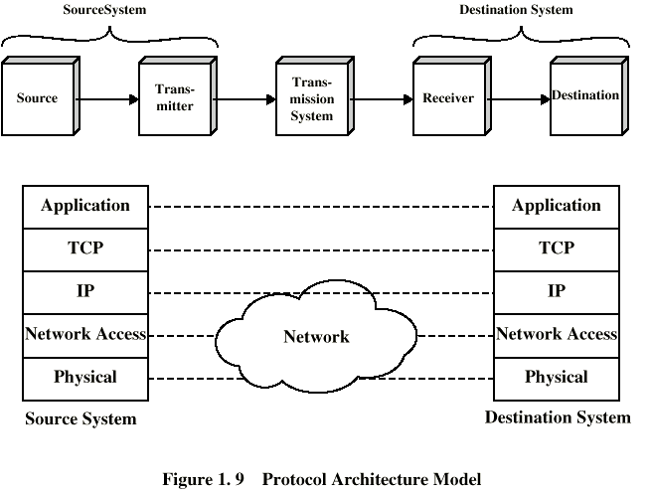
TCP/IP Architectural Model

Slide 10
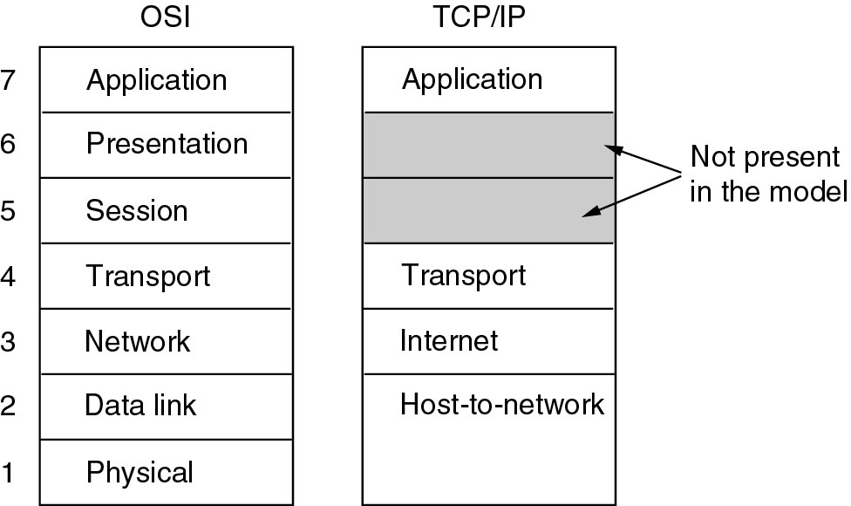
OSI versus TCP/IP
Tanenbaum

Slide 11
Internet Protocol Stack
application: supporting network applications
FTP, SMTP, HTTP
transport: process-process data transfer
TCP, UDP
network: routing of datagrams from source to destination
IP, routing protocols
link: data transfer between neighboring network elements
PPP, Ethernet
application
transport
network
link
physical

Slide 12
TCP/IP Protocols
HTTP
SMTP
DNS
RTP
TCP
UDP
IP
Network
Interface 1
Network
Interface 2
Network
Interface 3

Slide 13
Layering Example
Client/server relationship
Server process waits for incoming requests by listening to a port.
Client process makes requests as required.
Server process provides responses to these requests.
The server process usually runs in the background as a daemon (e.g. httpd is the server daemon for HTTP)

Slide 14
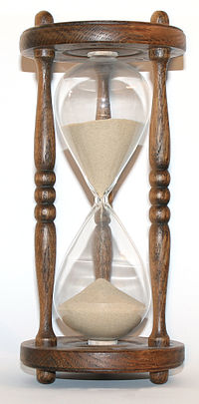
Internet Protocol (IP)
Currently IP provides best-effort service.
packets may be lost
General IP design philosophy
Keep the core internal operations simple
Push complication to the hosts/edge
End host: recover lost packets and congestion control
Operate over any network
This design allows IP to scale

Slide 15
Names and Numbers
The Internet Protocol (IP) uses numbers to identify hosts
IPv4: 32 bit identifiers
Example: 1.2.3.4
IPv6: 128 bit identifiers
2001:0db8:85a3:0000:0000:8a2e:0370:7334
These numbers are used for routing.
No other identifier is technically needed for communication

Slide 16
Names and Numbers – 2
Humans are not good with IP addresses
What is the IP address for the CS web page?
Instead, we give them mnemonic names
www.cs.wpi.edu => means nothing to the router
Hierarchical names (for administration)
Use the Domain Name System (DNS) to translate between IP addresses and names
130.215.36.26, obviously!

Slide 17
IPv4
Uses 32 bit hierarchical address space with location information embedded in the structure.
IP address is usually expressed in dotted-decimal notation
e.g., 128.100.11.56
Network ID
Host ID
4 bytes

Slide 18
IPv6
IPv6 addresses are 128 bits long.
16 bytes of IPv6 address are represented as a group of hexadecimal digits, separated by colons
2000:fdb8:0000:0000:0001:00ab:853c:39a1
Shorthand – leave out groups of zeros and leading zeros.
2000:fdb8:::1:ab:853c:39a1

Slide 19
What’s a Protocol?
Human protocols:
“What’s the time?”
Say “hi” first
“I have a question”
Raise hand first
… specific msgs sent
… specific actions taken when msgs received, or other events
Network protocols:
Machines rather than humans
All communication activity in Internet governed by protocols
Protocols:
1) define format
2) order of messages, and
3) actions taken upon transmission, receipt

Slide 20


What’s a Protocol?
A human protocol and a computer network protocol:
Hi
TCP connection
request
Hi
TCP connection
response
Got the
time?
Get http://www.awl.com/kurose-ross
2:00
<file>
time

Slide 21
HTTP Example
HTTP (HyperText Transfer Protocol) specifies rules by which the client and the server interact so as to retrieve a document.
The protocol assumes the client and the server can exchange messages directly.
The client software needs to set up a two-way connection prior to the HTTP request.

Slide 22
HTTP Client/Server Interaction
Request
HTTP
client
HTTP
server
Response
Copyright ©2000 The McGraw Hill Companies
Leon-Garcia & Widjaja: Communication Networks
Figure 2.1

Slide 23
HTTP/TCP Layering Interface
HTTP
client
HTTP
server
Ephemeral
Port #
Port 80
GET 80, #
TCP
TCP
#, 80 STATUS

Slide 24
HTTP Encapsulation Example
HTTP Request
Header contains source and destination port numbers
TCP Header
Header contains source and destination IP addresses; transport protocol type
IP Header
Header contains source and destination physical addresses; network protocol type
Frame Check Sequence
Ethernet Header

Slide 25
Encapsulation Animation
source
message
M
application
transport
network
link
physical
segment
H_{t}
M
H_{t}
datagram
H_{n}
H_{n}
H_{t}
M
frame
H_{l}
H_{n}
H_{t}
M
link
physical
switch
destination
H_{n}
H_{t}
M
network
link
physical
M
application
transport
network
link
physical
H_{l}
H_{n}
H_{t}
M
H_{n}
H_{t}
M
H_{t}
M
H_{n}
H_{t}
M
H_{l}
H_{n}
H_{t}
M
router

Slide 26
Internet Structure: Network of Networks
roughly hierarchical
at center: “tier-1” ISPs (e.g., Verizon, Sprint, AT&T, Cable and Wireless), national/international coverage
treat each other as equals => peers
Typically do not pay each other for service (under peer agreements)
Tier-1 providers interconnect (peer) privately
Tier 1 ISP
Tier 1 ISP
Tier 1 ISP

Slide 27
Tier-1 ISP: e.g., Sprint
POP: point-of-presence
to/from backbone
…
peering
….
…
…
…
to/from customers

Slide 28
Internet Structure: Network of Networks
“Tier-2” ISPs: smaller (often regional) ISPs
Connect to one or more tier-1 ISPs, possibly other tier-2 ISPs
Tier-2 ISPs also peer privately with each other.
Tier-2 ISP pays tier-1 ISP for connectivity to rest of Internet
tier-2 ISP is customer of
tier-1 provider
Tier-2 ISP
Tier-2 ISP
Tier 1 ISP
Tier 1 ISP
Tier 1 ISP
Tier-2 ISP
Tier-2 ISP
Tier-2 ISP

Slide 29
Internet Structure: Network of Networks
“Tier-3” ISPs and local ISPs
last hop (“access”) network (closest to end systems)
local
ISP
Tier 3
ISP
local
ISP
local
ISP
local
ISP
Local and tier- 3 ISPs are customers of
higher tier ISPs
connecting them to rest of Internet
Tier-2 ISP
Tier-2 ISP
Tier 1 ISP
Tier 1 ISP
Tier 1 ISP
Tier-2 ISP
Tier-2 ISP
Tier-2 ISP
local
ISP
local
ISP
local
ISP
local
ISP

Slide 30
Internet Structure: Network of Networks
a packet passes through many networks!
local
ISP
Tier 3
ISP
local
ISP
local
ISP
local
ISP
Tier-2 ISP
Tier-2 ISP
Tier 1 ISP
Tier 1 ISP
Tier 1 ISP
Tier-2 ISP
Tier-2 ISP
Tier-2 ISP
local
ISP
local
ISP
local
ISP
local
ISP

Slide 31
Activity
What makes a peer?
Level 3 vs. Comcast
What does this have to do with Netflix or “net neutrality”?
Transmit movies (a lot of comm) to audience via internet
Subscribed to Tier-1 ISP
Share this information with a CDN (Level 3)
Level 3 is also a Tier-1 ISP (note Comcast was not a Tier-1 at that point and was a subscriber of Tier-1)
Netflix was transmitting a lot of data to Comcast customers without paying Comcast
Customers are paying Comcast to get connectivity to Netflix

Slide 32
Elementary TCP Sockets
Contents from
UNIX Network Programming
Vol. 1, Second Ed. Stevens
Chapter 4
Optional Reading
http://beej.us/guide/bgnet/

Slide 33
TCP Sockets Outline
Socket Address Structure
TCP and UDP call Sequences
Socket
Connect
Bind
Listen
Accept
Close
Example: TCP Echo Server and Client [old]

Slide 34
IPv4 Socket Address Structure
The Internet socket address structure is named sockaddr_in
and is defined by including <netinet/in.h> header.
struct in_addr {
in_addr_t s_addr /* 32-bit IP address */
}; /* network byte ordered */
struct sockaddr_in {
uint8_t sin_len; /* length of structure (16) */
sa_family_t sin_family; /* AF_INET */
in_port_t sin_port; /* 16-bit TCP or UDP port number */
/* network byte ordered */
struct in_addr sin_addr; /* 32-bit IPv4 address */
/* network byte ordered */
char sin_zero[8]; /* unused */
};

Slide 35
The Socket Interface
socket interface
Application 1
Application 2
socket interface
user
user
kernel
kernel
Socket
Socket
Underlying communication Protocols
Underlying communication Protocols
Communications network

Slide 36
TCP Socket Calls
Server
socket()
bind()
listen()
Client
accept()
socket()
blocks until server receives
connect negotiation
a connect request from client
connect()
read()
data
write()
write()
data
read()
close()
close()

Slide 37
UDP Socket Calls
Server
socket()
Client
socket()
bind()
Not needed
bind()
recvfrom()
blocks until server
sendto()
receives data from client
data
sendto()
data
recvfrom()
close()
close()

Slide 38
System Calls for Elementary TCP Sockets
#include <sys/types.h>
#include <sys/socket.h>
family: specifies the protocol family {AF_INET for TCP/IP}
type: indicates communications semantics
SOCK_STREAM stream socket TCP
SOCK_DGRAM datagram socket UDP
SOCK_RAW raw socket
protocol: set to IPPROTO_TCP for TCP
returns on success: socket descriptor {a small nonnegative integer}
on error: -1
Example:
if (( sd = socket (AF_INET, SOCK_STREAM, IPPROTO_TCP)) < 0) err_sys (“socket call error”);
socket Function
int socket ( int family, int type, int protocol );

Slide 39
Connect Function
int connect (int sockfd, const struct sockaddr *servaddr,
socklen_t addrlen);
sockfd: a socket descriptor returned by the socket function
*servaddr: a pointer to a socket address structure
addrlen: the size of the socket address structure
The socket address structure must contain the IP address and the port number for the connection wanted.
In TCP connect initiates a three-way handshake. connect returns only when the connection is established or when an error occurs.
returns on success: 0
on error: -1
Example:
if ( connect (sd, (struct sockaddr *) &servaddr, sizeof (servaddr)) != 0)
err_sys(“connect call error”);

Slide 40
TCP Socket Calls
Server
socket()
bind()
listen()
Client
accept()
socket()
blocks until server receives
connect negotiation
a connect request from client
connect()
read()
data
write()
write()
data
read()
close()
close()

Slide 41
Bind Function
int bind (int sockfd, const struct sockaddr *myaddr, socklen_t addrlen);
bind assigns a local protocol address to a socket.
protocol address: a 32 bit IPv4 address and a 16 bit TCP or UDP port number.
sockfd: a socket descriptor returned by the socket function.
*myaddr: a pointer to a protocol-specific address.
addrlen: the size of the socket address structure.
Servers bind their “well-known port” when they start.
returns on success: 0
on error: -1
Example:
if (bind (sd, (struct sockaddr *) &servaddr, sizeof (servaddr)) != 0)
errsys (“bind call error”);

Slide 42
Listen Function
int listen (int sockfd, int backlog);
listen is called only by a TCP server and performs two actions:
1. Converts an unconnected socket (sockfd) into a passive socket.
2. Specifies the maximum number of connections (backlog) that the kernel should queue for this socket.
listen is normally called before the accept function.
returns on success: 0
on error: -1
Example:
if (listen (sd, 2) != 0) errsys (“listen call error”);

Slide 43
Accept Function
int accept (int sockfd, struct sockaddr *cliaddr, socklen_t *addrlen);
accept is called by the TCP server to return the next completed connection from the front of the completed connection queue.
sockfd: This is the same socket descriptor as in listen call.
*cliaddr: used to return the protocol address of the connected peer process (i.e., the client process).
*addrlen: {this is a value-result argument}
before the accept call: We set the integer value pointed to by *addrlen to the size of the socket address structure pointed to by *cliaddr.
on return from the accept call: This integer value contains the actual number of bytes stored in the socket address structure.
returns on success: a new socket descriptor
on error: -1

Slide 44
Accept Function
int accept (int sockfd, struct sockaddr *cliaddr, socklen_t *addrlen);
For accept the first argument sockfd is the listening socket
and the returned value is the connected socket.
The server will have one connected socket for each client connection accepted.
When the server is finished with a client, the connected socket must be closed.
Example:
sfd = accept (sd, NULL, NULL);
if (sfd == -1) err_sys (“accept error”);
connected socket

Slide 45
Close Function
int close (int sockfd );
close marks the socket as closed and returns to the process immediately.
sockfd: This socket descriptor is no longer useable.
Note – TCP will try to send any data already queued to the other end before the normal connection termination sequence.
returns on success: 0
on error: -1
Example:
close (sfd);

Slide 46
TCP Echo Server
#include <stdio.h> /* for printf() and fprintf() */
#include <sys/socket.h> /* for socket(), bind(), and connect() */
#include <arpa/inet.h> /* for sockaddr_in and inet_ntoa() */
#include <stdlib.h> /* for atoi() and exit() */
#include <string.h> /* for memset() */
#include <unistd.h> /* for close() */
#define MAXPENDING 5 /* Maximum outstanding connection requests */
void DieWithError(char *errorMessage); /* Error handling function */
void HandleTCPClient(int clntSocket); /* TCP client handling function */
D&C

Slide 47
TCP Echo Server (cont)
int main(int argc, char *argv[])
{ int servSock; /*Socket descriptor for server */
int clntSock; /* Socket descriptor for client */
struct sockaddr_in echoServAddr; /* Local address */
struct sockaddr_in echoClntAddr; /* Client address */
unsigned short echoServPort; /* Server port */
unsigned int clntLen; /* Length of client address data structure */
if (argc != 2) /* Test for correct number of arguments */
{
fprintf(stderr, "Usage: %s <Server Port>\n", argv[0]);
exit(1);
}
echoServPort = atoi(argv[1]); /* First arg: local port */
/* Create socket for incoming connections */
if ((servSock = socket (AF_INET, SOCK_STREAM, IPPROTO_TCP)) < 0)
DieWithError("socket() failed");
D&C

Slide 48
TCP Echo Server (cont)
/* Construct local address structure */
memset(&echoServAddr, 0, sizeof(echoServAddr)); /* Zero out structure */
echoServAddr.sin_family = AF_INET; /* Internet address family */
echoServAddr.sin_addr.s_addr = htonl(INADDR_ANY); /* Any incoming interface */
echoServAddr.sin_port = htons(echoServPort); /* Local port */
/* Bind to the local address */
if (bind (servSock, (struct sockaddr *) &echoServAddr, sizeof(echoServAddr)) < 0)
DieWithError("bind() failed");
/* Mark the socket so it will listen for incoming connections */
if (listen (servSock, MAXPENDING) < 0)
DieWithError("listen() failed");
D&C

Slide 49
TCP Echo Server (cont)
for (;;) /* Run forever */
{
/* Set the size of the in-out parameter */
clntLen = sizeof(echoClntAddr); /* Wait for a client to connect */
if ((clntSock = accept (servSock, (struct sockaddr *) &echoClntAddr, &clntLen))
< 0) DieWithError("accept() failed");
/* clntSock is connected to a client! */
printf("Handling client %s\n", inet_ntoa(echoClntAddr.sin_addr));
HandleTCPClient(clntSock);
}
/* NOT REACHED */
}
D&C

Slide 50
TCP Echo Client
#include <stdio.h> /* for printf() and fprintf() */
#include <sys/socket.h> /* for socket(), connect(), send(), and recv() */
#include <arpa/inet.h> /* for sockaddr_in and inet_addr() */
#include <stdlib.h> /* for atoi() and exit() */
#include <string.h> /* for memset() */
#include <unistd.h> /* for close() */
#define RCVBUFSIZE 32 /* Size of receive buffer */
void DieWithError(char *errorMessage); /* Error handling function */
D&C

Slide 51
TCP Echo Client (cont)
int main(int argc, char *argv[])
{
int sock; /* Socket descriptor */
struct sockaddr_in echoServAddr; /* Echo server address */
unsigned short echoServPort; /* Echo server port */
char *servIP; /* Server IP address (dotted quad) */
char *echoString; /* String to send to echo server */
char echoBuffer[RCVBUFSIZE]; /* Buffer for echo string */
unsigned int echoStringLen; /* Length of string to echo */
int bytesRcvd, totalBytesRcvd; /* Bytes read in single recv() and total bytes read */
if ((argc < 3) || (argc > 4)) /* Test for correct number of arguments */
{
fprintf(stderr, "Usage: %s <Server IP> <Echo Word> [<Echo Port>]\n",
argv[0]);
exit(1)
}
D&C

Slide 52
TCP Echo Client (cont)
servIP = argv[1]; /* First arg: server IP address (dotted quad) */
echoString = argv[2]; /* Second arg: string to echo */
if (argc == 4)
echoServPort = atoi(argv[3]); /* Use given port, if any */
else
echoServPort = 7; /* 7 is the well-known port for the echo service */
/* Create a reliable, stream socket using TCP */
if ((sock = socket (AF_INET, SOCK_STREAM, IPPROTO_TCP)) < 0)
DieWithError("socket() failed");
/* Construct the server address structure */
memset(&echoServAddr, 0, sizeof(echoServAddr)); /* Zero out structure */
echoServAddr.sin_family = AF_INET; /* Internet address family */
echoServAddr.sin_addr.s_addr = inet_addr(servIP); /* Server IP address */
echoServAddr.sin_port = htons(echoServPort); /* Server port */
D&C

Slide 53
TCP Echo Client (cont)
/* Establish the connection to the echo server */
if (connect (sock, (struct sockaddr *) &echoServAddr, sizeof(echoServAddr)) < 0) DieWithError("connect() failed");
echoStringLen = strlen(echoString); /* Determine input length */
/* Send the string to the server */
if (send (sock, echoString, echoStringLen, 0) != echoStringLen)
DieWithError("send() sent a different number of bytes than expected");
/* Receive the same string back from the server */
totalBytesRcvd = 0; /* Count of total bytes received */
printf("Received: "); /* Setup to print the echoed string */
D&C

Slide 54
TCP Echo Client (cont)
while (totalBytesRcvd < echoStringLen)
{
/* Receive up to the buffer size (minus 1 to leave space for
a null terminator) bytes from the sender */
if ((bytesRcvd = recv (sock, echoBuffer, RCVBUFSIZE - 1, 0)) <= 0) DieWithError("recv() failed or connection closed prematurely");
totalBytesRcvd += bytesRcvd; /* Keep tally of total bytes */
echoBuffer[bytesRcvd] = '\0'; /* Terminate the string! */
printf("%s", echoBuffer); /* Print the echo buffer */
}
printf("\n"); /* Print a final linefeed */
close (sock);
exit(0);
}
D&C

Slide 55
TCP Sockets Summary
Sockets Address Structure
TCP and UDP Call Sequences
Socket
Connect
Bind
Listen
Accept
Close
TCP Echo Server and Client [old]

Slide 56
TCP Socket Calls
Server
socket()
bind()
listen()
Client
accept()
socket()
blocks until server receives
connect negotiation
a connect request from client
connect()
read()
data
write()
write()
data
read()
close()
close()

Slide 57
UDP Socket Calls
Server
socket()
Client
socket()
bind()
Not needed
bind()
recvfrom()
blocks until server
sendto()
receives data from client
data
sendto()
data
recvfrom()
close()
close()

